Slide 1
Image Caption Generator
Project Members:
- Revanth Sai Gowrisetty (rsg230005)
- Karthika Shalini Potail (ksp230004)

Slide 2
Goal of the Project
The goal of this project is to generate meaningful and accurate captions for loaded images.
Train the model with the flickr8k data.

Slide 3
Scope of the Project
This project focuses on:
- Loading images and extracting their features using CNNs.
-Using LSTMs for natural language generation
- Evaluating the quality of generated captions

Slide 4
Problems and Difficulties Faced
Some challenges faced:
- Handling large datasets and preprocessing
- Training time (4 hours) and requirement of powerful GPU’s.
- Having less GPU power, we have to settle with less number of epochs.

Slide 5
Interesting Things in the Project
Interesting aspects include:
- Used personal photos of mine and friends to evaluate the results.
It was our first to use CNN to extract the image features.

Slide 6
Lessons Learned
Lessons learned from this project:
- preprocessing of the data was extensive.
- Fine-tuning models for better results.
- Integrating different AI domains (CV + NLP).

Slide 7
Future Steps
Future improvements:
- Use transformer-based models for better captions
- Optimize the pipeline for faster generation
- Deploy as a web or mobile application
- Include BLEU scores to understand the results better.

Slide 8
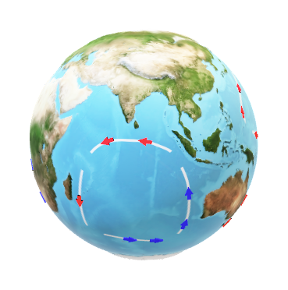
Thank You

